Slide 1
Gottfrid sample A (center ?)

Slide 2
Edge of deposition

Slide 3
Actual edge of Cu sample, no Li (?)

Slide 4
Saw black parts with spots
Started bubbling after taking picture (see below)
Josef thinks it might have been salt

Slide 8
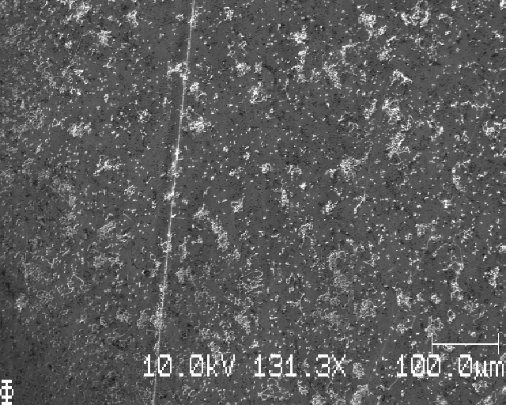
Edge of deposition, more sparse Li

Slide 9
Close by, more dense Li

Slide 10
Closer to edge of sample, Li?

Slide 11
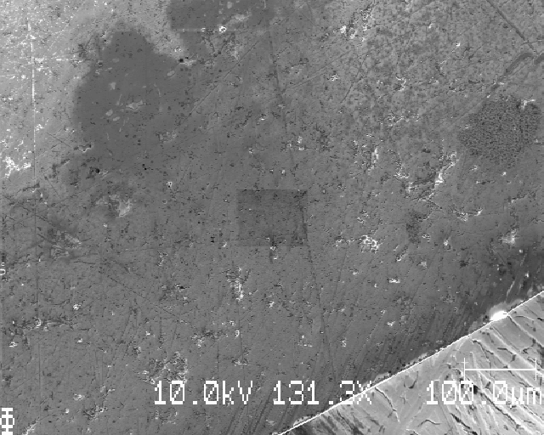
At edge, no nucleated Li

Slide 12
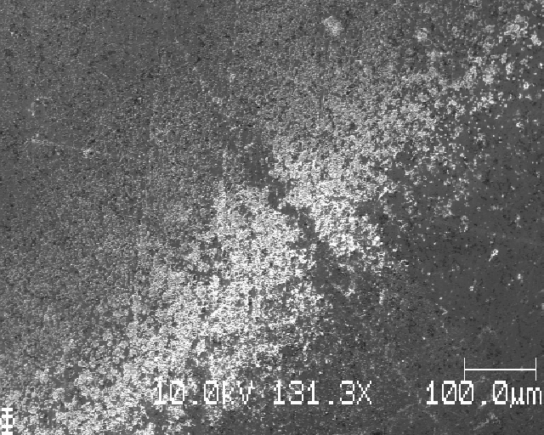
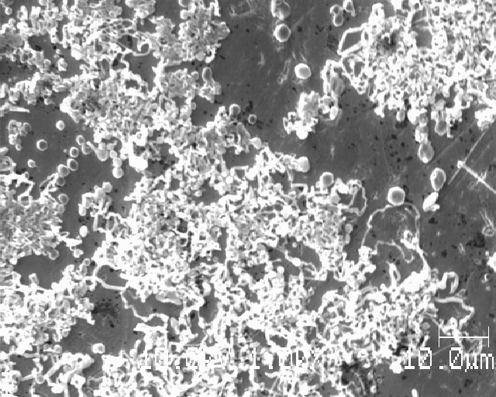
Edge of Li deposition, more spaghetti-like

Slide 13
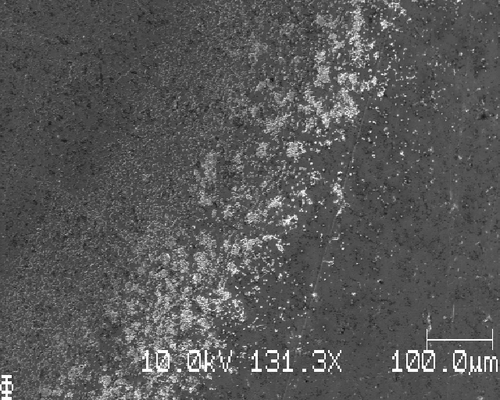
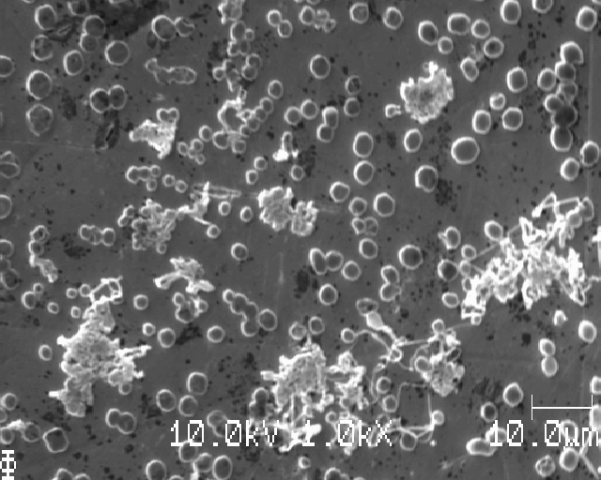
Edge of Li deposition

Slide 14
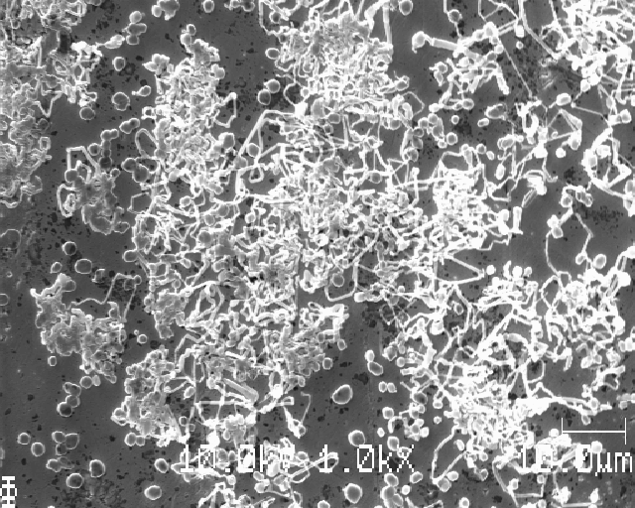
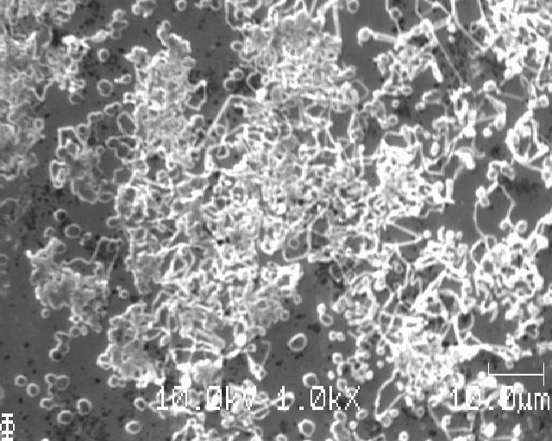
Edge of Li deposition

Slide 15
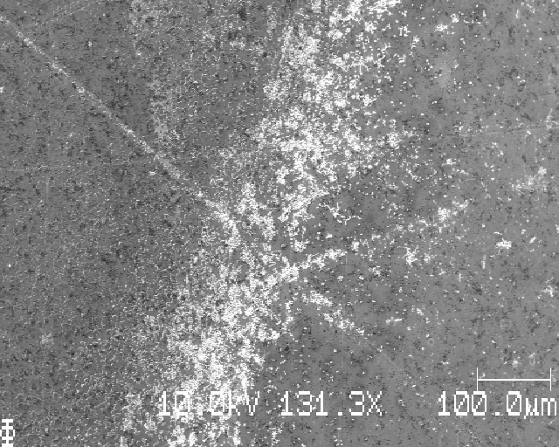
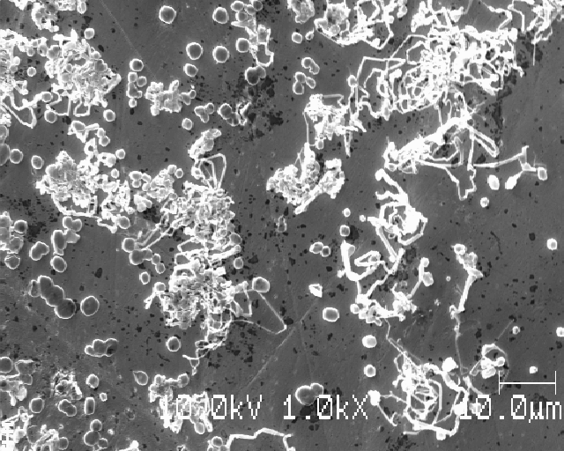
Starting from this edge, moving inwards (arrow)

Slide 16
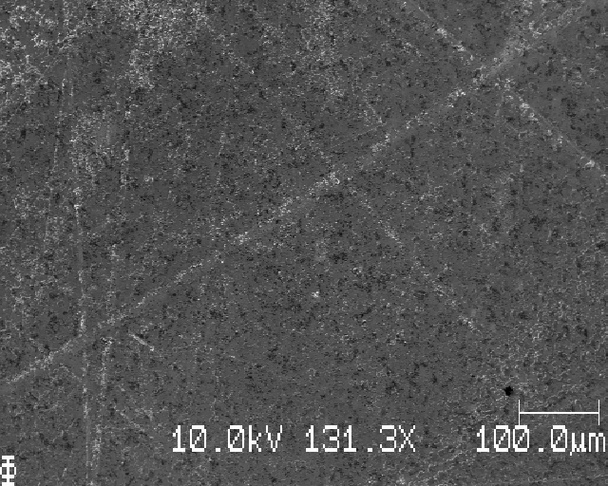
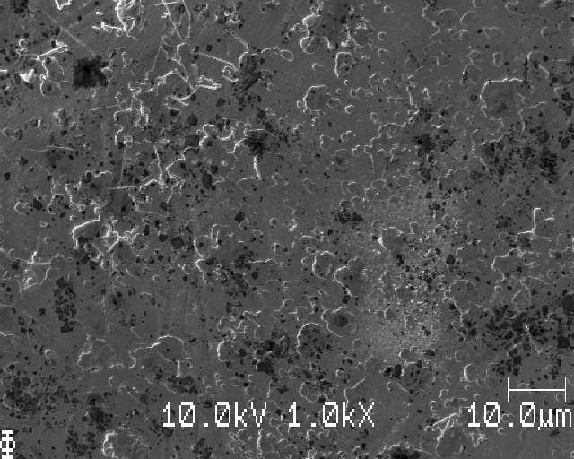
About 1mm in from edge of deposition

Slide 17
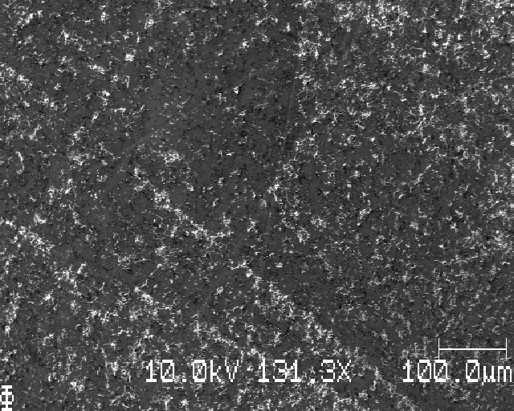
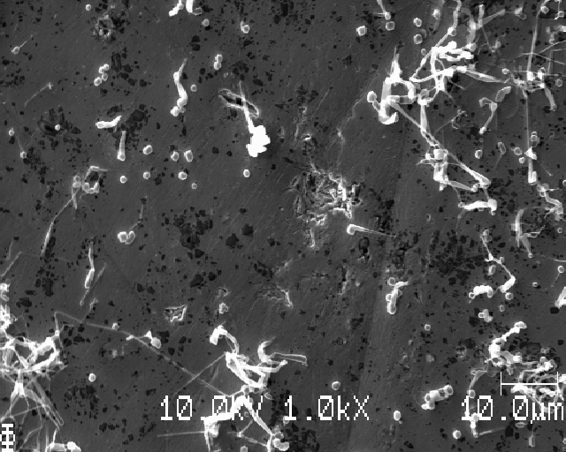
About 2mm in from edge of deposition

Slide 18
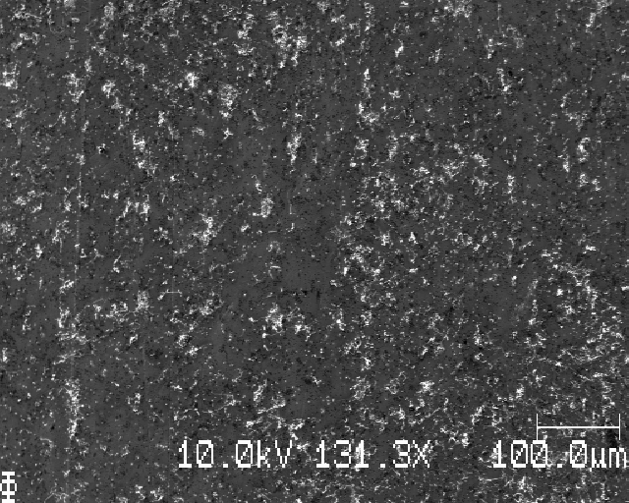
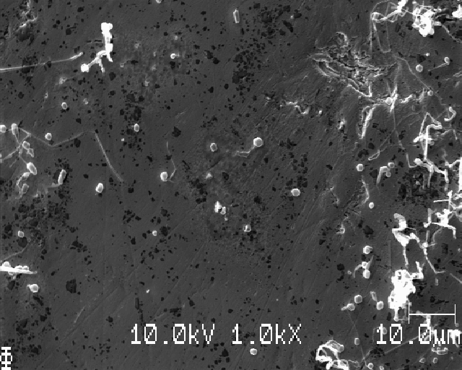
About 3mm in from edge of deposition

Slide 19
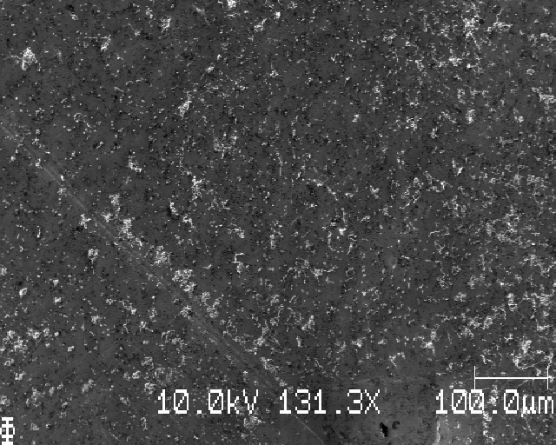
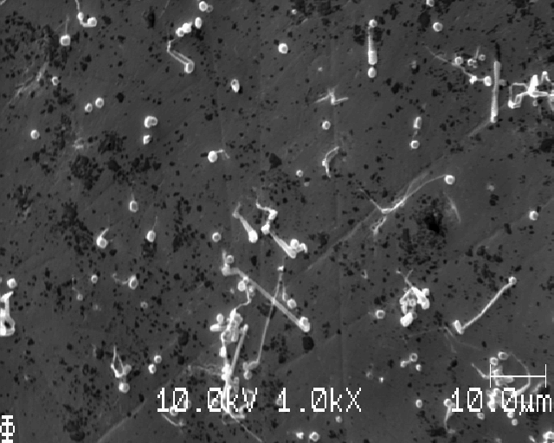
About 4mm in from edge of deposition

Slide 21
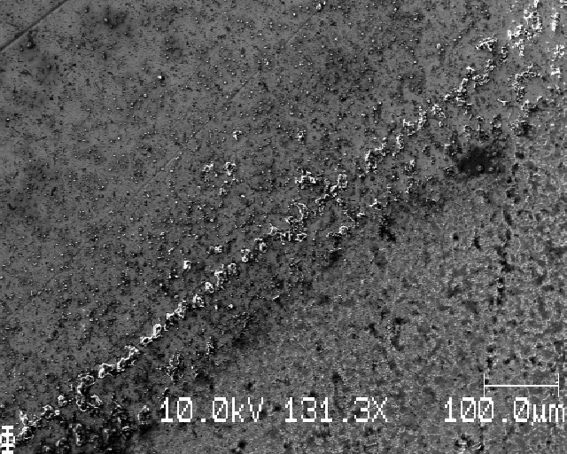
Sample B, edge of something (not Li)

Slide 22
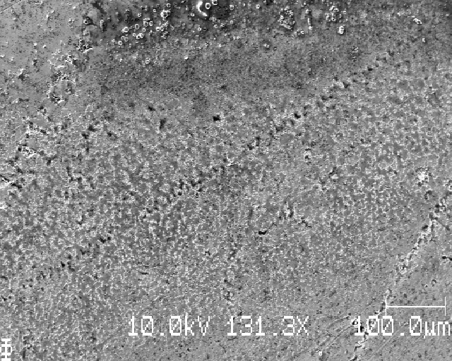
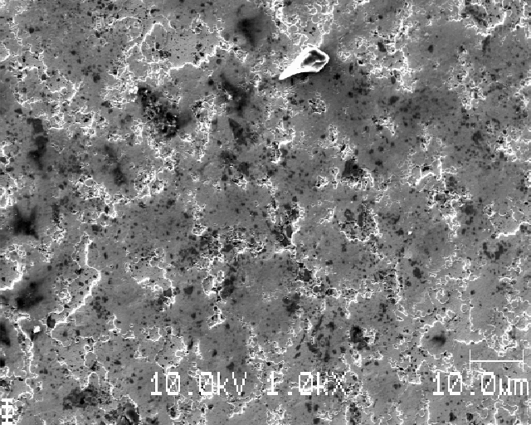

Slide 23
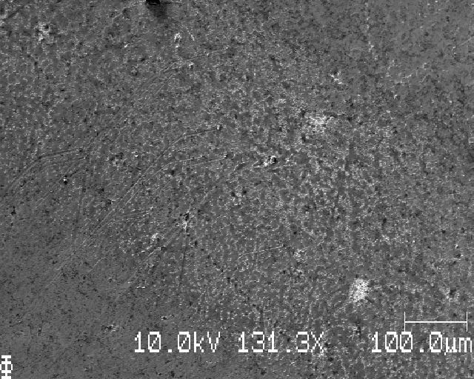
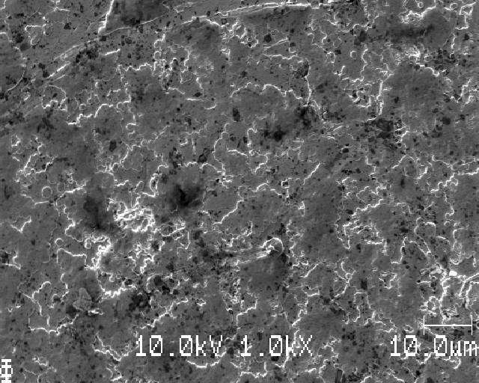
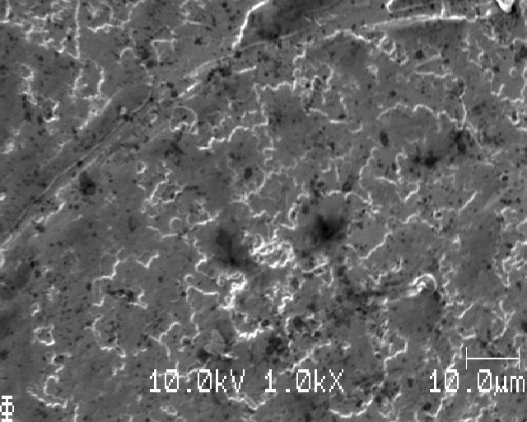
Edge of deposition?

Slide 24
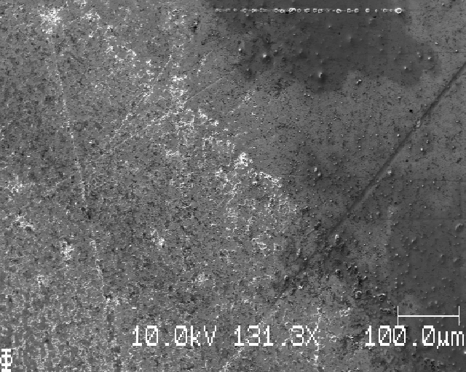
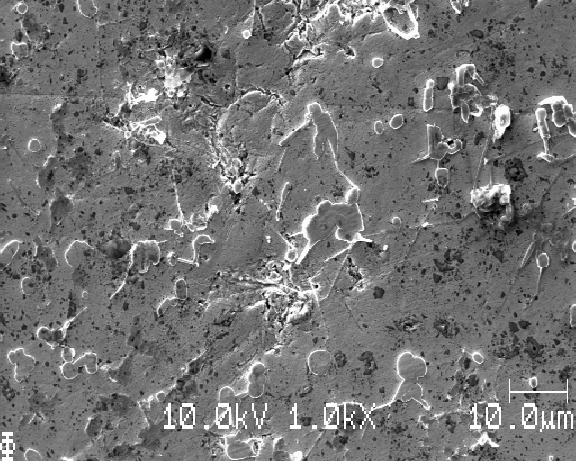
Edge of deposition (EoD)

Slide 25
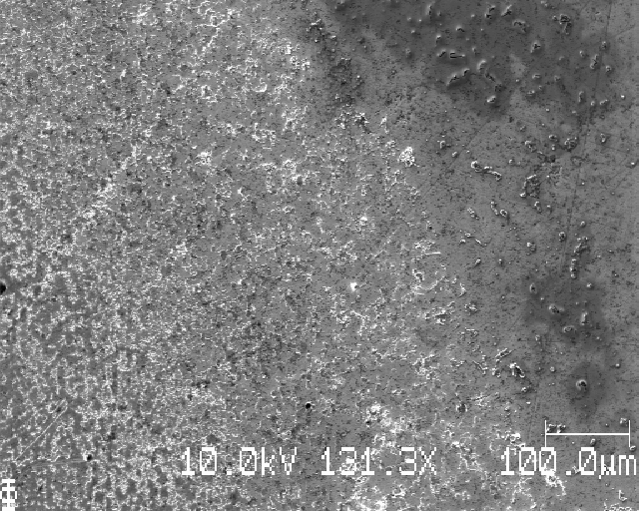
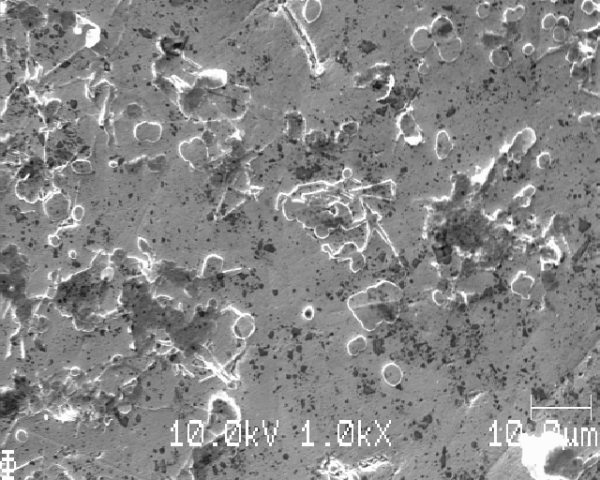
EoD

Slide 26
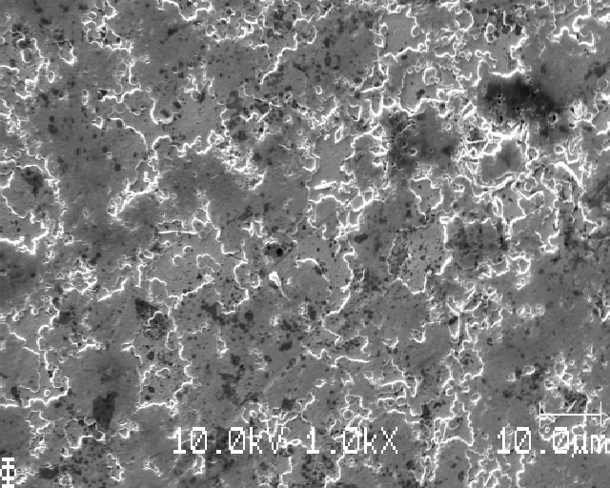
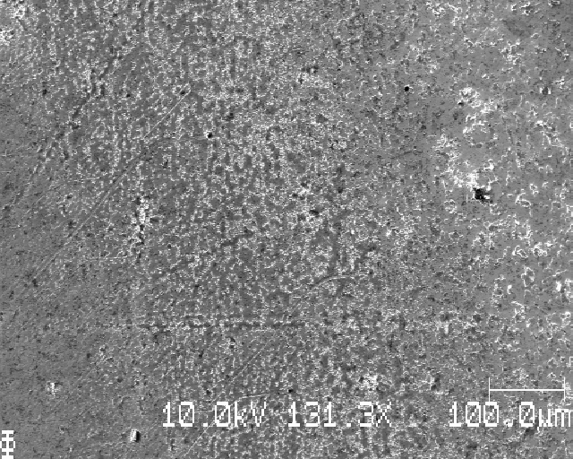
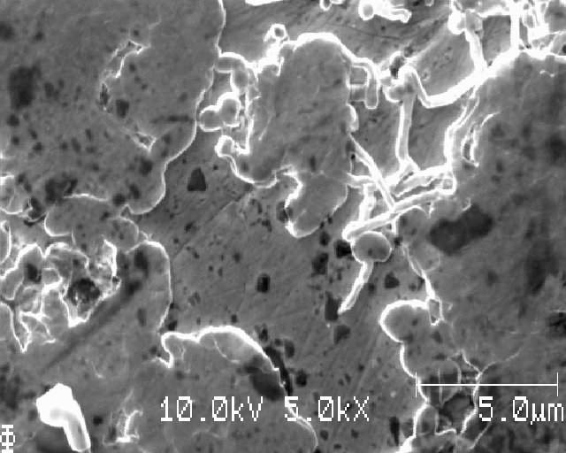
EoD

Slide 27
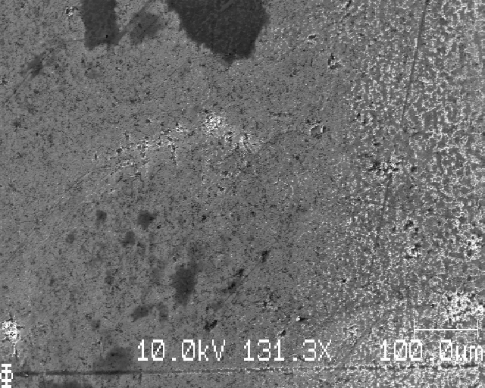
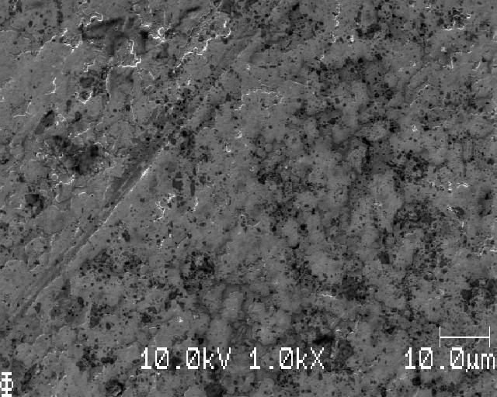
0.3 mm in from the EoD in previous slide

Slide 28
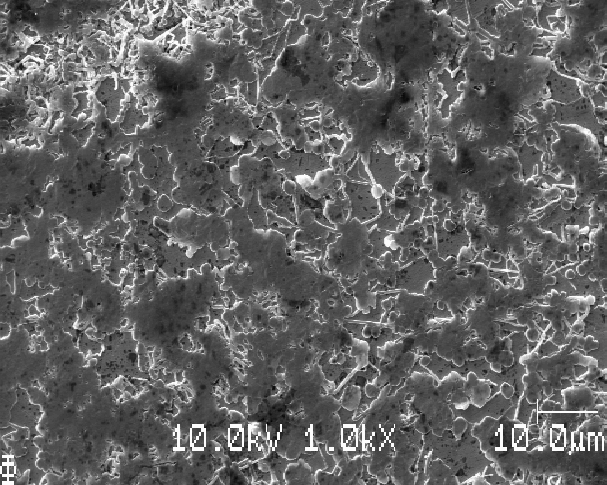
EoD

Slide 29
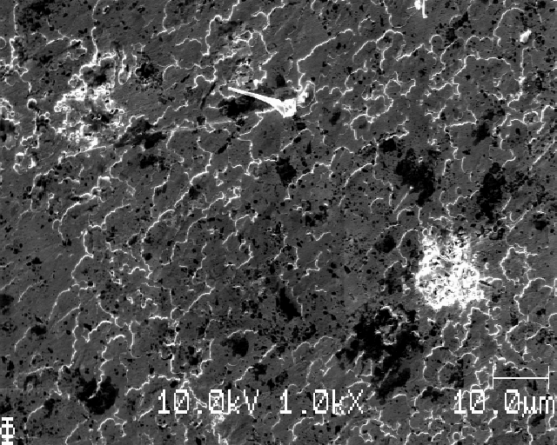
0.3 mm from EOD

Slide 30
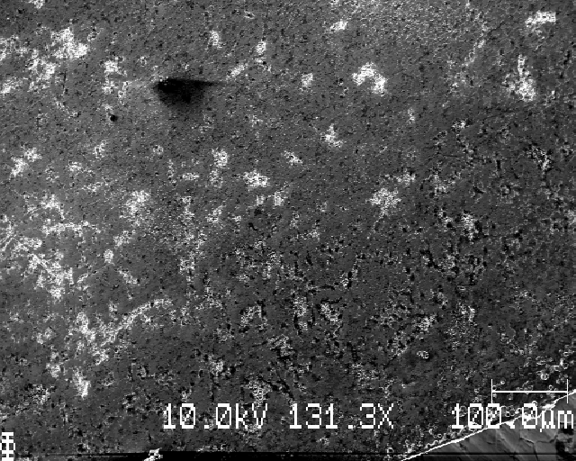
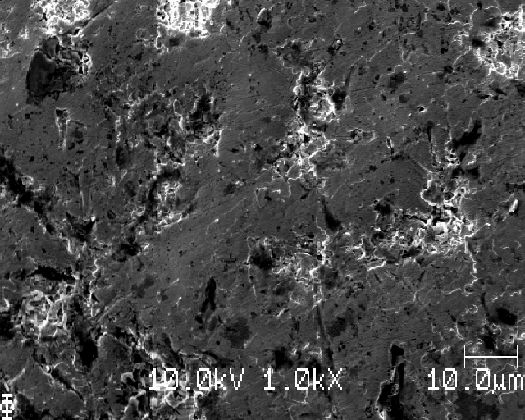
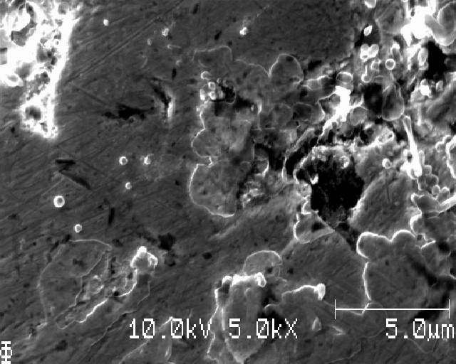
EoD

Slide 31
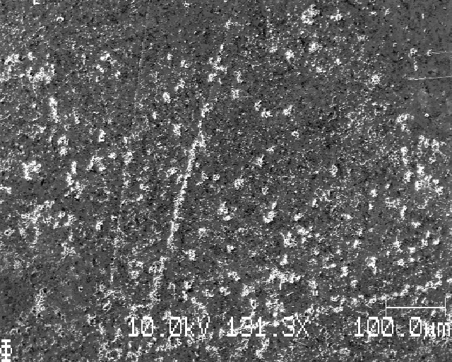
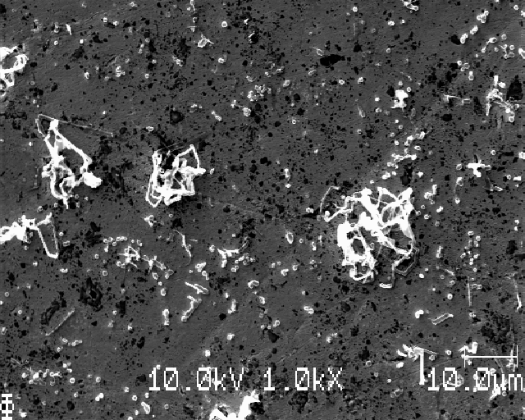
EoD (?)

Slide 32
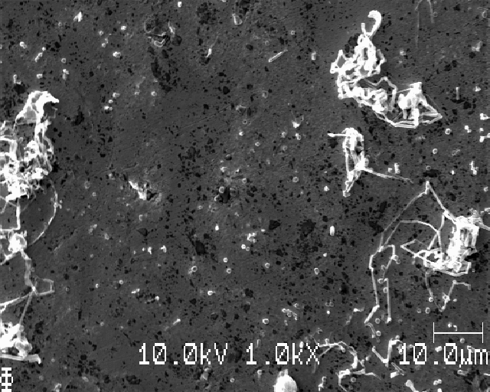
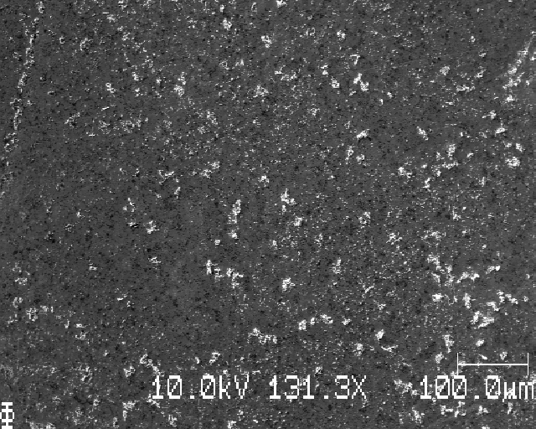
EoD

Slide 33
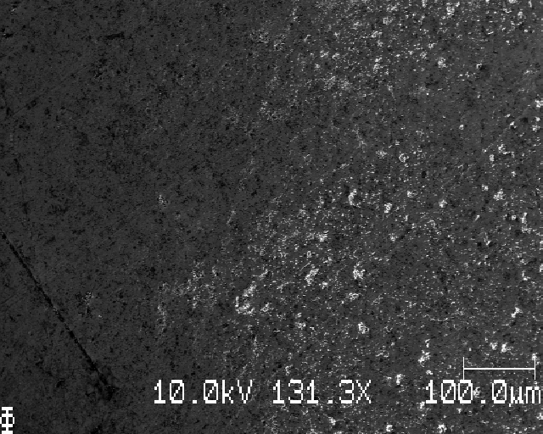
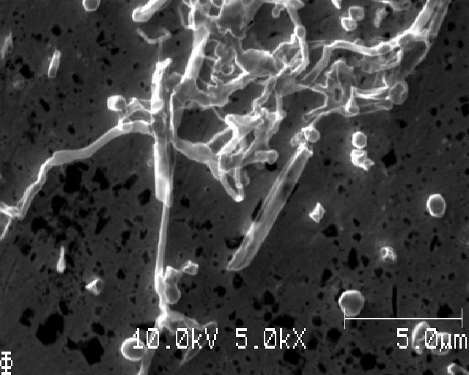
EoD

Slide 34
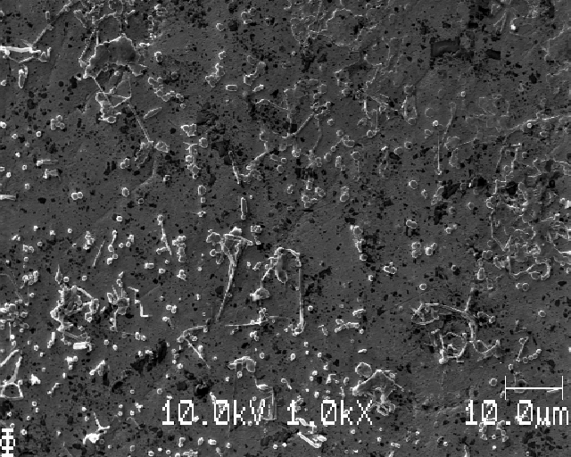
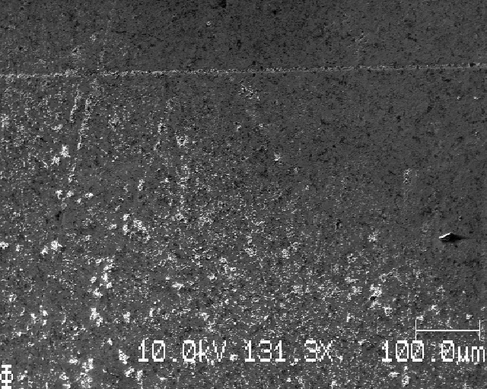
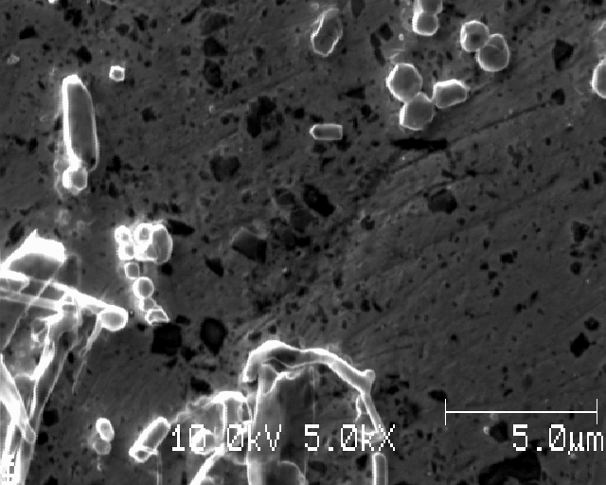
EoD

Slide 35
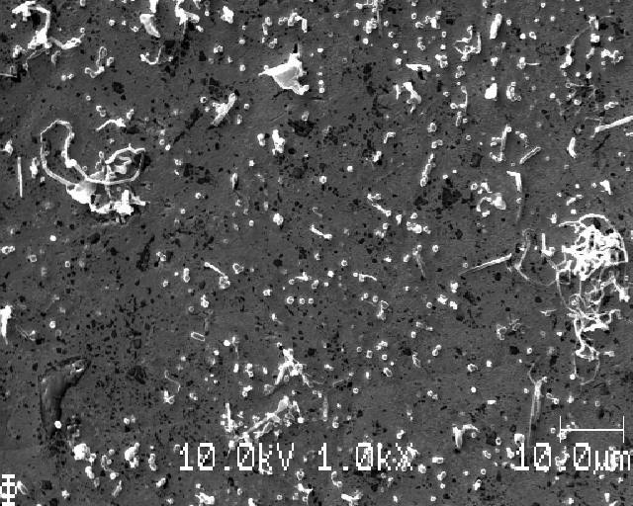
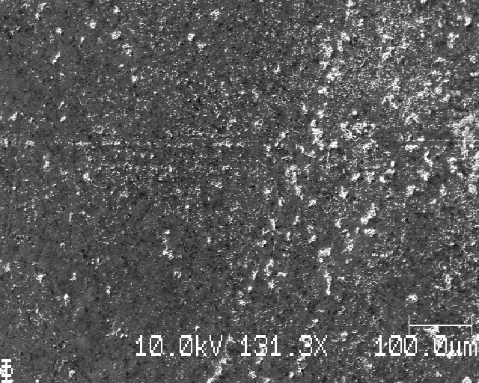
1 mm towards center from EoD

Slide 36
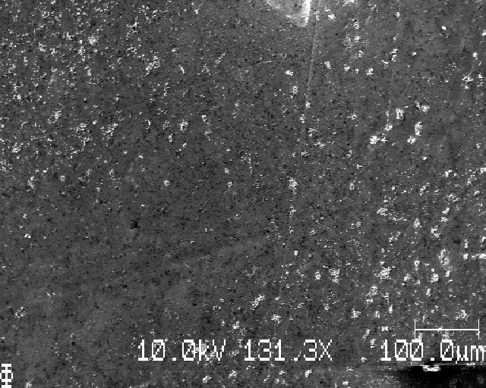

2mm towards center from EoD

Slide 37


3mm towards center from EoD

Slide 38


4 mm towards center from EoD

Slide 40




Sample D, center

Slide 41



Sample D, center

Slide 43


Sample C, edge

Slide 44



Sample C, EoD or outside
Lots of bubbles formed in this region

Slide 45


Further towards center, EoD?

Slide 46



EoD

Slide 47



Further towards egdge *from last position

Slide 48



EoD

Slide 49



EoD

Slide 50
Beam damage to Li
Pictures taken a few seconds apart at high mag

Slide 51



1 mm towards center from EoD

Slide 52



2mm towards center from EoD

Slide 53



3 mm towards center from EoD

Slide 54



4mm towards center from EoD

